Slide 1
Chapter 12
Describing Distributions with Numbers
Lecture Slides

Slide 2
Case Study: Describing Distributions with Numbers 1
Does education pay? We are told that people with more education earn more, on the average, than people with less education.
How much more? How can we answer this question? Data on income can be found at the Census Bureau website.
The data are estimates for the year 2013 of the total incomes of 136,641,000 people aged 25 and over, with earnings, and are based on the results of the Current Population Survey in 2014.

Slide 3
Case Study: Describing Distributions with Numbers 2
The website gives the income distribution for each of several education categories.
It gives the number of people in each of several education categories who earned between $1 and $2499, between $2500 and $4999, up to between $97,500 and $99,999, and $100,000 and over. That is a lot of information.
A histogram could be used to display the data, but are there simple ways to summarize the information with just a few numbers that allow us to make sensible comparisons?

Slide 4
Case Study: Describing Distributions with Numbers 3
In this chapter, we will learn several ways to summarize large data sets with a few numbers. By the end of this chapter, with these new methods for summarizing large data sets, you will be able to provide an answer to whether education really pays.

Slide 5
Describing Distributions with Numbers 1
Baseball has a rich tradition of using statistics to summarize and characterize the performance of players. We begin by investigating ways to summarize the performance of the greatest home-run hitters of all time. In the summer of 2007, Barry Bonds shattered the career home-run record, breaking the previous record set by Hank Aaron. Here are his home-run counts for the years 1986 (his rookie year) to 2007 (his final season):
1986 1987 1988 1989 1990 1991 1992 1993 1994 1995 1996 16 25 24 19 33 25 34 46 37 33 42
1997 1998 1999 2000 2001 2002 2003 2004 2005 2006 2007 40 37 34 49 73 46 45 45 5 26 28

Slide 6
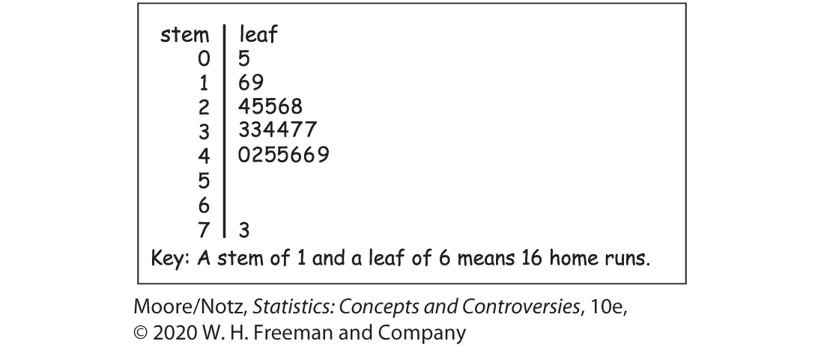
Describing Distributions with Numbers 2
The shape of the distribution is a bit irregular, but we see that it has one high outlier, and if we ignore this outlier, we might describe it as slightly skewed to the left with a single peak.
The outlier is Bonds’s record season in 2001.

Slide 7
Median and Quartiles 1
A simple and effective way to describe center and variability is to give the median and the quartiles.
The median is the midpoint, the value that separates the smaller half of the observations from the larger half.
The quartiles get their name because, with the median, they divide the observations into quarters: one-quarter of the observations lie below the first quartile, one half lies below the median, and three-quarters lie below the third quartile. That’s the idea. To actually get numbers, we need a rule that makes the idea exact.

Slide 8
Example: Finding the median
We might compare Bonds’s career with that of Hank Aaron, the previous holder of the career record. Here are Aaron’s home-run counts for his 23 years in baseball:
13 27 26 44 30 39 40 34 45 44 24 32 44 39 29 44 38 47 34 40 20 12 10
To find the median, first arrange them in order from smallest to largest:
There is an odd number of observations, so the median is the middle value.

Slide 9
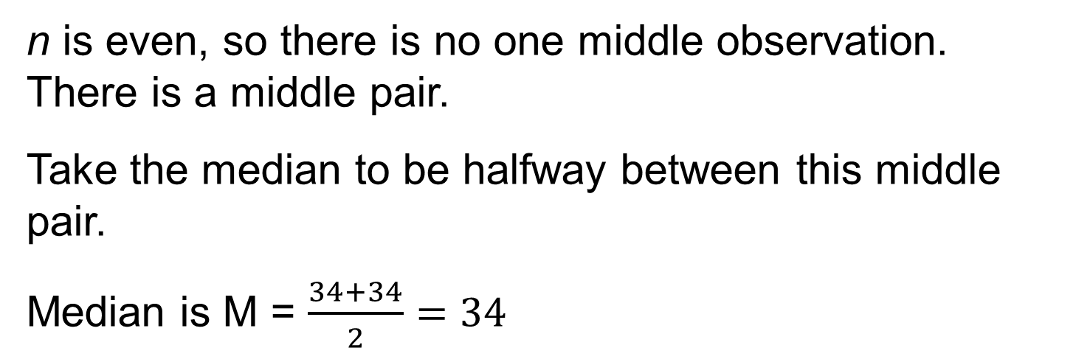
Example: Finding the median (continued)
How does this compare with Bonds’s record? Here are Bonds’s 22 home run counts, arranged in order from smallest to largest:
n is even, so there is no one middle observation. There is a middle pair.
Take the median to be halfway between this middle pair.
Median is M = $\frac{34+34}{2}=34$

Slide 10
Median and Quartiles 2
The median (M) is the midpoint of a distribution, the number such that one half of the observations is smaller and the other half is larger. To find the median of a distribution:
Arrange all observations in order of size, from smallest to largest.
If the number of observations n is odd, the median (M) is the center observation in the ordered list. Find the location of the median by counting (n + 1)/2 observations up from the bottom of the list.
If the number of observations n is even, the median (M) is the average of the two center observations in the ordered list. The location of the median is again (n + 1)/2 from the bottom of the list.

Slide 11
Median and Quartiles 3
The Census Bureau website provides data on income inequality. For example, it tells us that in 2013 the median income of Hispanic households was $40,963. That’s helpful but incomplete.
Do most Hispanic households earn close to this amount, or are the incomes very variable?
The simplest useful description of a distribution consists of both a measure of center and a measure of variability.

Slide 12
Median and Quartiles 4
If we choose the median (the midpoint) to describe center, the quartiles (in particular, the difference between the quartiles) provide natural descriptions of variability.
The idea is clear: find the points one-quarter and three-quarters up the ordered list of observations. Again, we need a rule to make the idea precise. The rule for calculating the quartiles uses the rule for the median.

Slide 13
Median and Quartiles 5
To calculate the quartiles:
Arrange the observations in increasing order and locate the median (M) in the ordered list of observations.
The first quartile (Q₁) is the median of the observations whose position in the ordered list is to the left of the location of the overall median. The overall median is not included in the observations considered to be to the left of the overall median.
The third quartile (Q₃) is the median of the observations whose position in the ordered list is to the right of the location of the overall median. The overall median is not included in the observations considered to be to the right of the overall median.

Slide 14
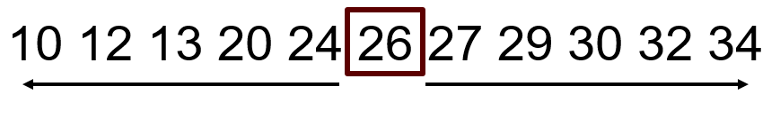

Example: Finding the quartiles
Find the quartiles for Hank Aaron’s home run distribution.
There is an odd number of observations, so the median is the middle value.
The lower half of the data is:
The upper half of the data is:

Slide 15
Five-Number Summary and Boxplots 1
The five-number summary of a distribution consists of the smallest observation, the first quartile, the median, the third quartile, and the largest observation, written in order from smallest to largest. In symbols, the five-number summary is
Minimum Q₁ M Q₃ Maximum

Slide 16
Five-Number Summary and Boxplots 2
A boxplot is a graph of the five-number summary.
A central box spans the quartiles.
A line in the box marks the median.
Lines extend from the box out to the smallest and largest observations.

Slide 17
Five-Number Summary and Boxplots 3
Boxplots can be drawn horizontally or vertically. Be sure to include a numerical scale in the graph.
When you look at a boxplot, first locate the median, which marks the center of the distribution. Then look at the variability.
The quartiles (more precisely, the difference between the two quartiles) show the variability of the middle half of the data, and the extremes (the smallest and largest observations) indicate the variability of the entire data set.

Slide 18
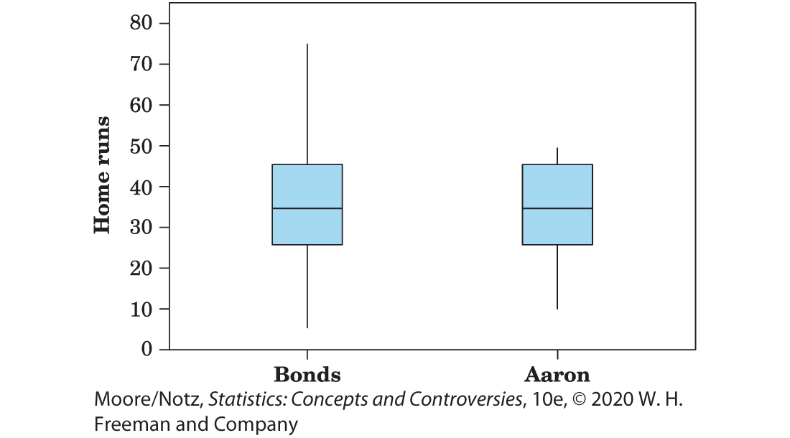
Five-Number Summary and Boxplots 4
We see from Figure 12.2 that Bonds’s usual performance, as indicated by the median and the box that marks the middle half of the distribution, is similar to that of Aaron. We also see that the distribution for Aaron is less variable than the distribution for Bonds.

Slide 19
Mean and Standard Deviation 1
The five-number summary is not the most common numerical description of a distribution. That distinction belongs to the combination of the mean to measure center and the standard deviation to measure variability.
The mean is the ordinary average of the observations.
The standard deviation gives the average distance of observations from the mean.
For now, just think of the standard deviation as “average distance from the mean” and leave the details to your calculator.

Slide 20
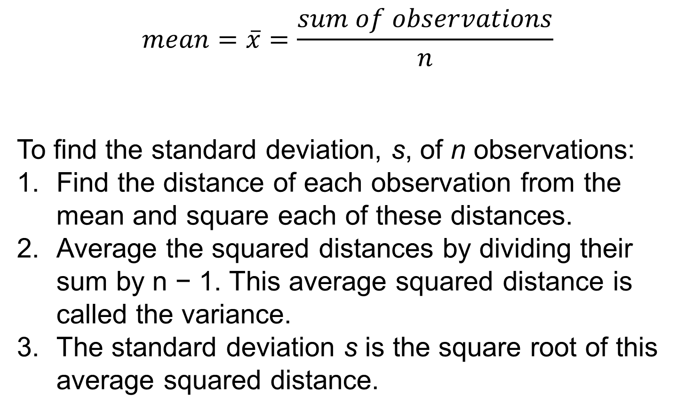
Mean and Standard Deviation 2
$$mean=\overline{x}=\frac{sum of observations}{n}$$
To find the standard deviation, s, of n observations:
Find the distance of each observation from the mean and square each of these distances.
Average the squared distances by dividing their sum by n − 1. This average squared distance is called the variance.
The standard deviation s is the square root of this average squared distance.

Slide 21
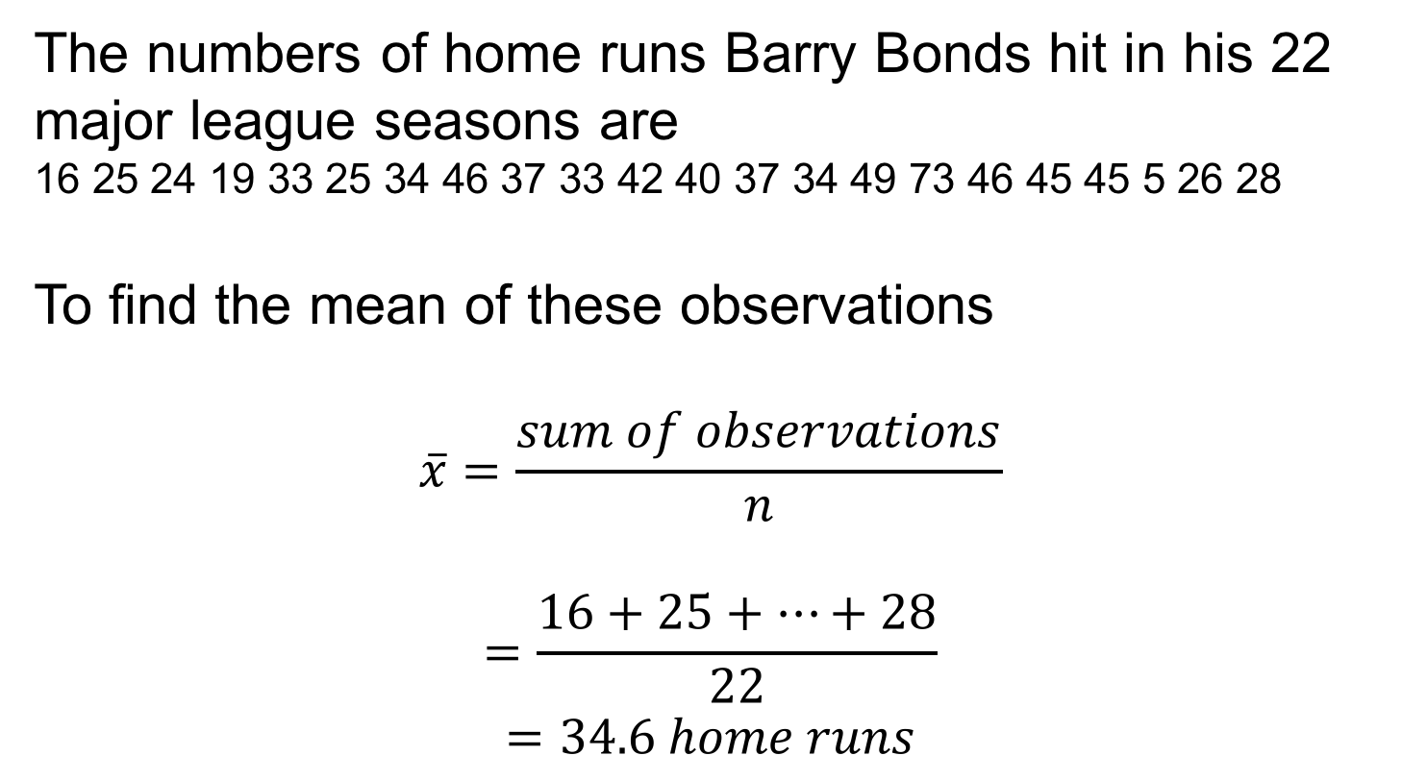
Example: Finding the mean and standard deviation 1
The numbers of home runs Barry Bonds hit in his 22 major league seasons are
16 25 24 19 33 25 34 46 37 33 42 40 37 34 49 73 46 45 45 5 26 28
To find the mean of these observations
$$\overline{x}=\frac{sum of observations}{n}$$
$$=\frac{16+25+…+28}{22}$$
$$=34.6 home runs$$

Slide 22
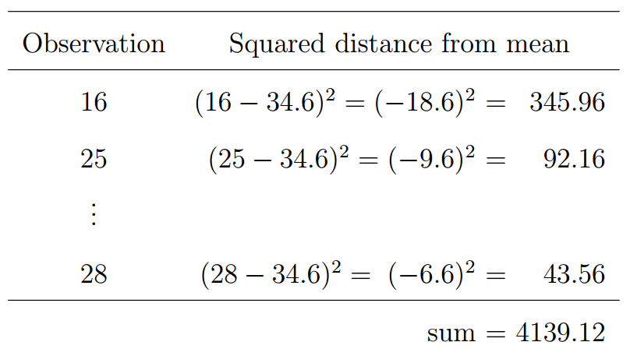
Example: Finding the mean and standard deviation 2
To find the standard deviation of these observations:

Slide 23
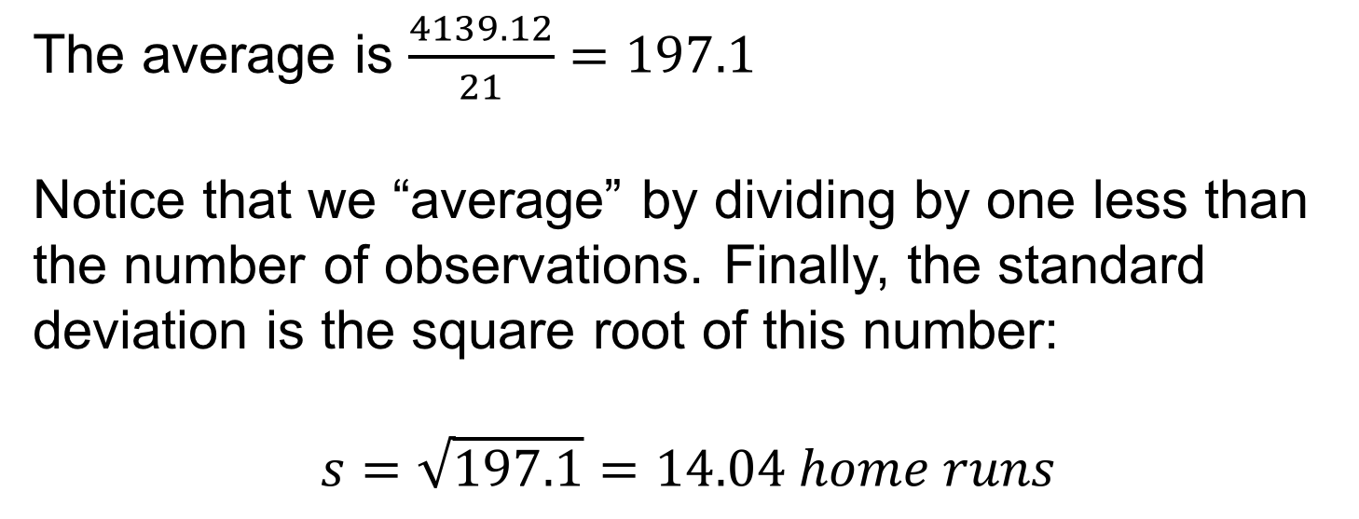
Example: Finding the mean and standard deviation 3
The average is $\frac{4139.12}{21}=197.1$
Notice that we “average” by dividing by one less than the number of observations. Finally, the standard deviation is the square root of this number:
$$s=\sqrt{197.1}=14.04 home runs$$

Slide 24
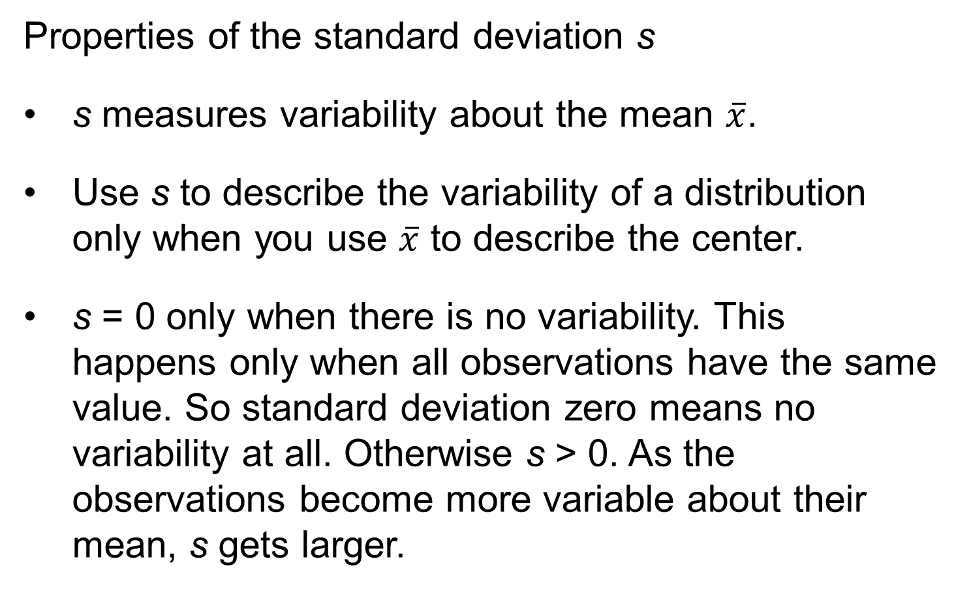
Mean and Standard Deviation 3
Properties of the standard deviation s
s measures variability about the mean $\overline{x}$.
Use s to describe the variability of a distribution only when you use $\overline{x}$ to describe the center.
s = 0 only when there is no variability. This happens only when all observations have the same value. So standard deviation zero means no variability at all. Otherwise s > 0. As the observations become more variable about their mean, s gets larger.

Slide 25
Choosing Numerical Descriptions 1
mean vs. median
The mean is strongly influenced by a few extreme observations.
The median is not.
If the distribution is
Symmetrical → mean = median
Skewed right → mean > median
Skewed left → mean < median

Slide 26
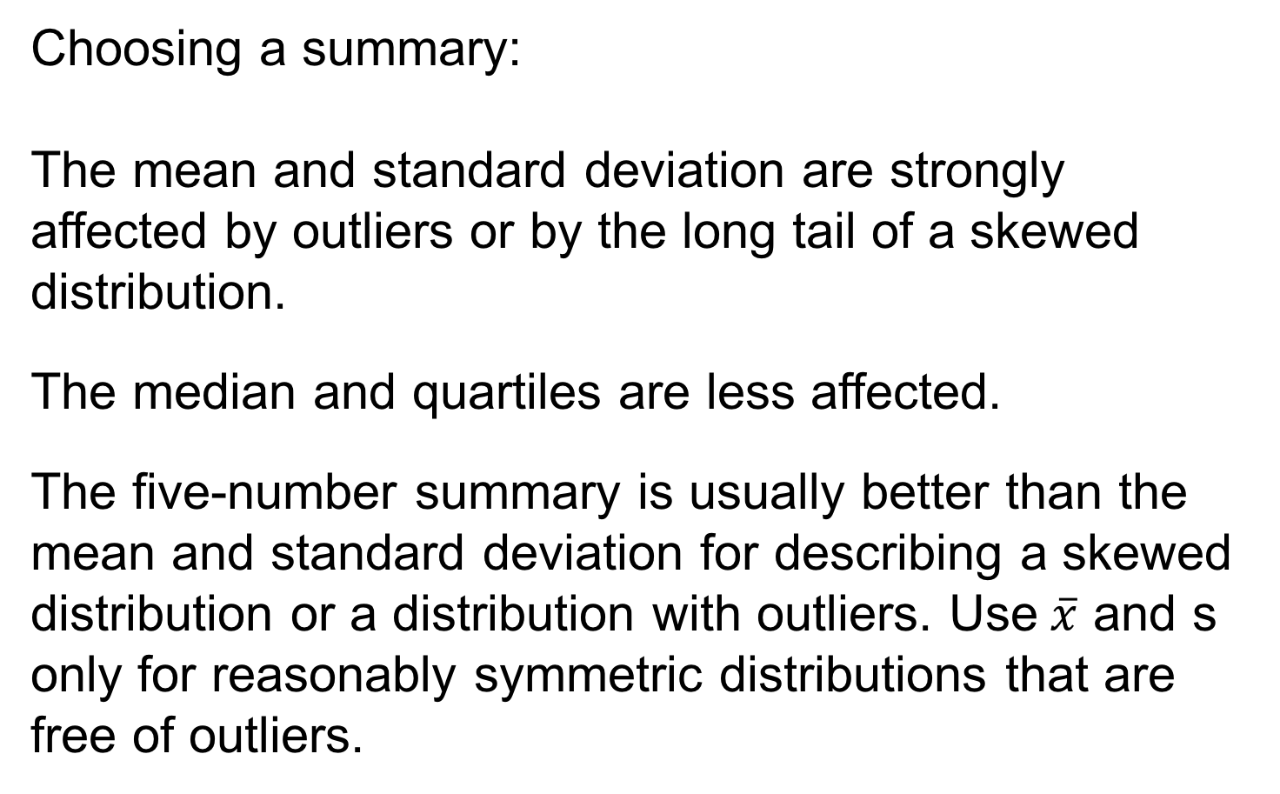
Choosing Numerical Descriptions 2
Choosing a summary:
The mean and standard deviation are strongly affected by outliers or by the long tail of a skewed distribution.
The median and quartiles are less affected.
The five-number summary is usually better than the mean and standard deviation for describing a skewed distribution or a distribution with outliers. Use$\overline{x}$ and s only for reasonably symmetric distributions that are free of outliers.

Slide 27
Choosing Numerical Descriptions 3
Numerical summaries do not disclose the presence of multiple peaks or gaps.
A picture will help you detect skewness and outliers.
Always start with a graph of your data!

Slide 28
Statistics in Summary 1
If we have data on a single quantitative variable, we start with a histogram or stemplot to display the distribution. Then we add numbers to describe the center and variability of the distribution.
There are two common descriptions of center and variability: the five-number summary and the mean and standard deviation.

Slide 29
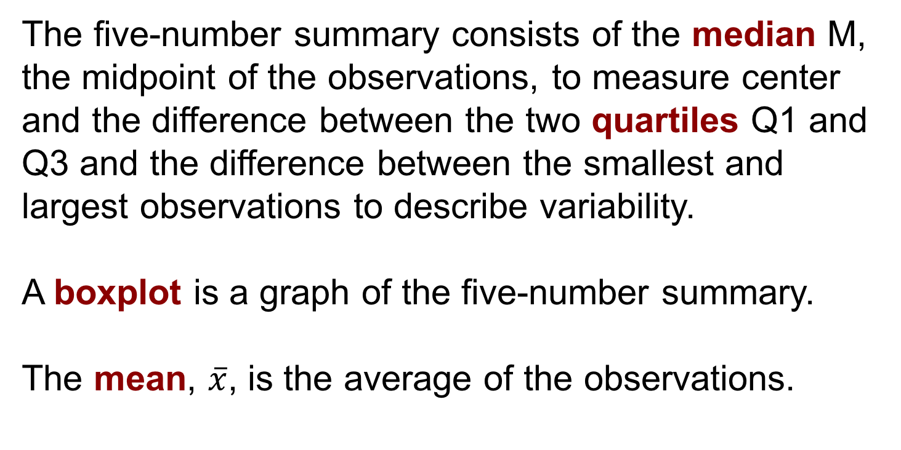
Statistics in Summary 2
The five-number summary consists of the median M, the midpoint of the observations, to measure center and the difference between the two quartiles Q1 and Q3 and the difference between the smallest and largest observations to describe variability.
A boxplot is a graph of the five-number summary.
The mean, $\overline{x}$, is the average of the observations.

Slide 30
Statistics in Summary 3
The standard deviation, s, measures variability as a kind of average distance from the mean, so use it only with the mean. The variance is the square of the standard deviation.
The mean and standard deviation can be changed a lot by a few outliers. The mean and median are the same for symmetrical distributions, but the mean moves farther toward the long tail of a skewed distribution.
In general, use the five-number summary to describe most distributions and the mean and standard deviation only for roughly symmetrical distributions.

